Slide 1
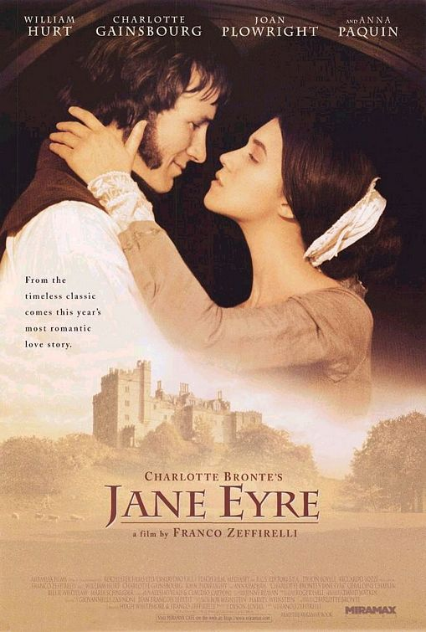
Jane Eyre
By
Charlote Bronte

Slide 2
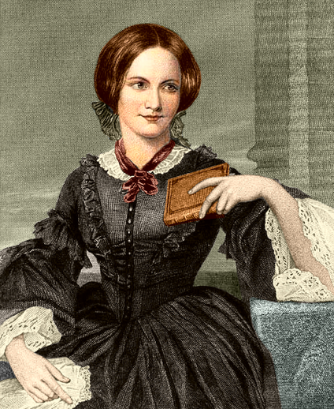
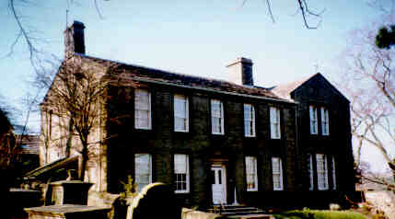
Charlotte Bronte
Was born of Irish ancestry in 1816
Lived at Haworth, a parsonage
Mother died of cancer when Charlotte was 5 years old.

Slide 3
Charlotte’s Religious Views
Father, Patrick Bronte, was an Anglican clergyman
Due to her upbringing, she often wrote about religious hypocrisy—those who preach one doctrine but live by another

Slide 4
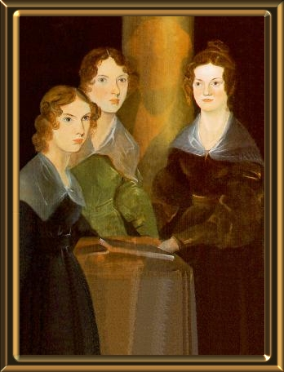
The Bronte Sisters
Charlotte had four sisters and one brother.
After their mother’s death, Brontë and her sisters were sent to the Clergy Daughters’ School.
  The food was bad
  Discipline was harsh
  Disease was rampant
Bronte’s two older sisters (Maria & Elizabeth) died of tuberculosis.

Slide 5
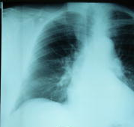
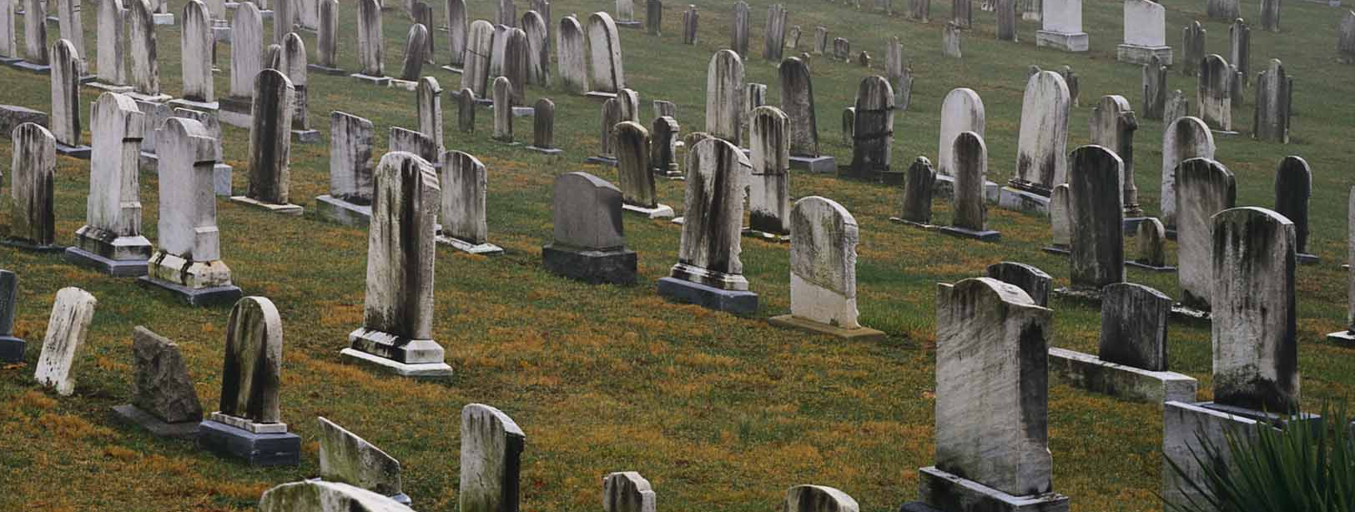
Tuberculosis
Tuberculosis was a common killer during the Victorian era.
Tuberculosis often destroys its victims’ lungs, resulting in a bloody cough.
If untreated, sufferers may die of tuberculosis because their lungs are so badly damaged.

Slide 6
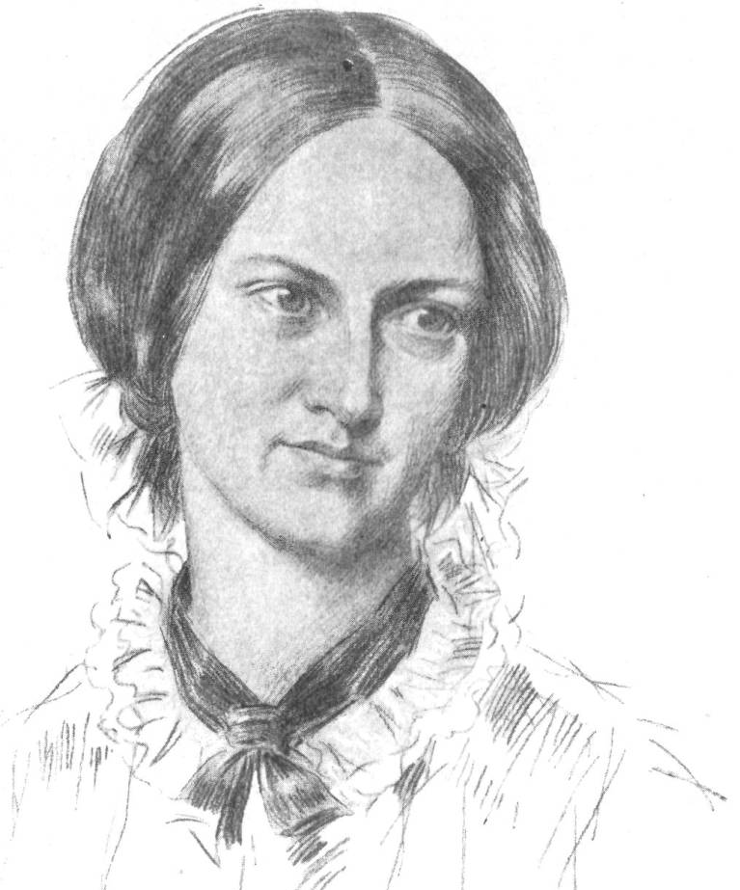
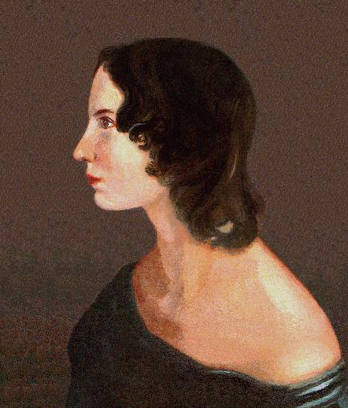
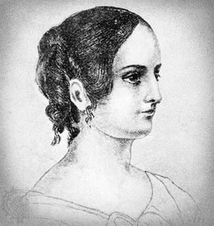
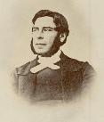
All in the Family
Charlotte Bronte
The Clergy Daughter’s School at Cowan Bridge would became the model for Lowood, the fictitious girls’ school in Jane Eyre.
Charlote’s sisters Anne and Emily Bronte both became successful writers.
In 1846, Charlotte & her sisters started publishing poems and began writing novels:
  The Professor was Charlotte’s attempt to fictionalize her love for a college professor she had met at Brussels.
  In 1847 Wuthering Heights was sister Emily’s first success. Charlotte followed with Jane Eyre.
Charlotte’s brother, Branwell, was a gifted painter.
Emily Bronte
Anne Bronte
Branwell Bronte

Slide 7
All 3 Bronte Sisters…
Used a masculine pen name because women writers were not taken seriously at that time in Victorian England.
Charlotte used the name Currer Bell.

Slide 8
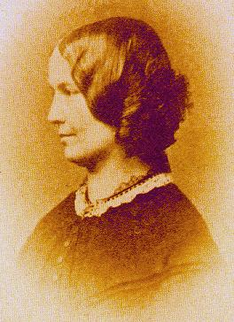
Marriage Bells
In 1854 Charlotte married her father's curate, Arthur Bell Nichols.
The next year, she became pregnant, then ill.
She died a month before her 39th birthday.

Slide 9
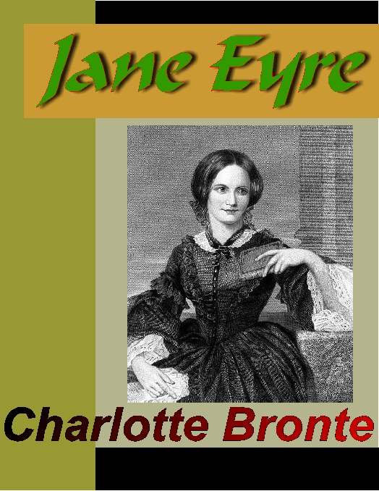
THE NOVEL
Jane Eyre was published in London in 1847.

Slide 10
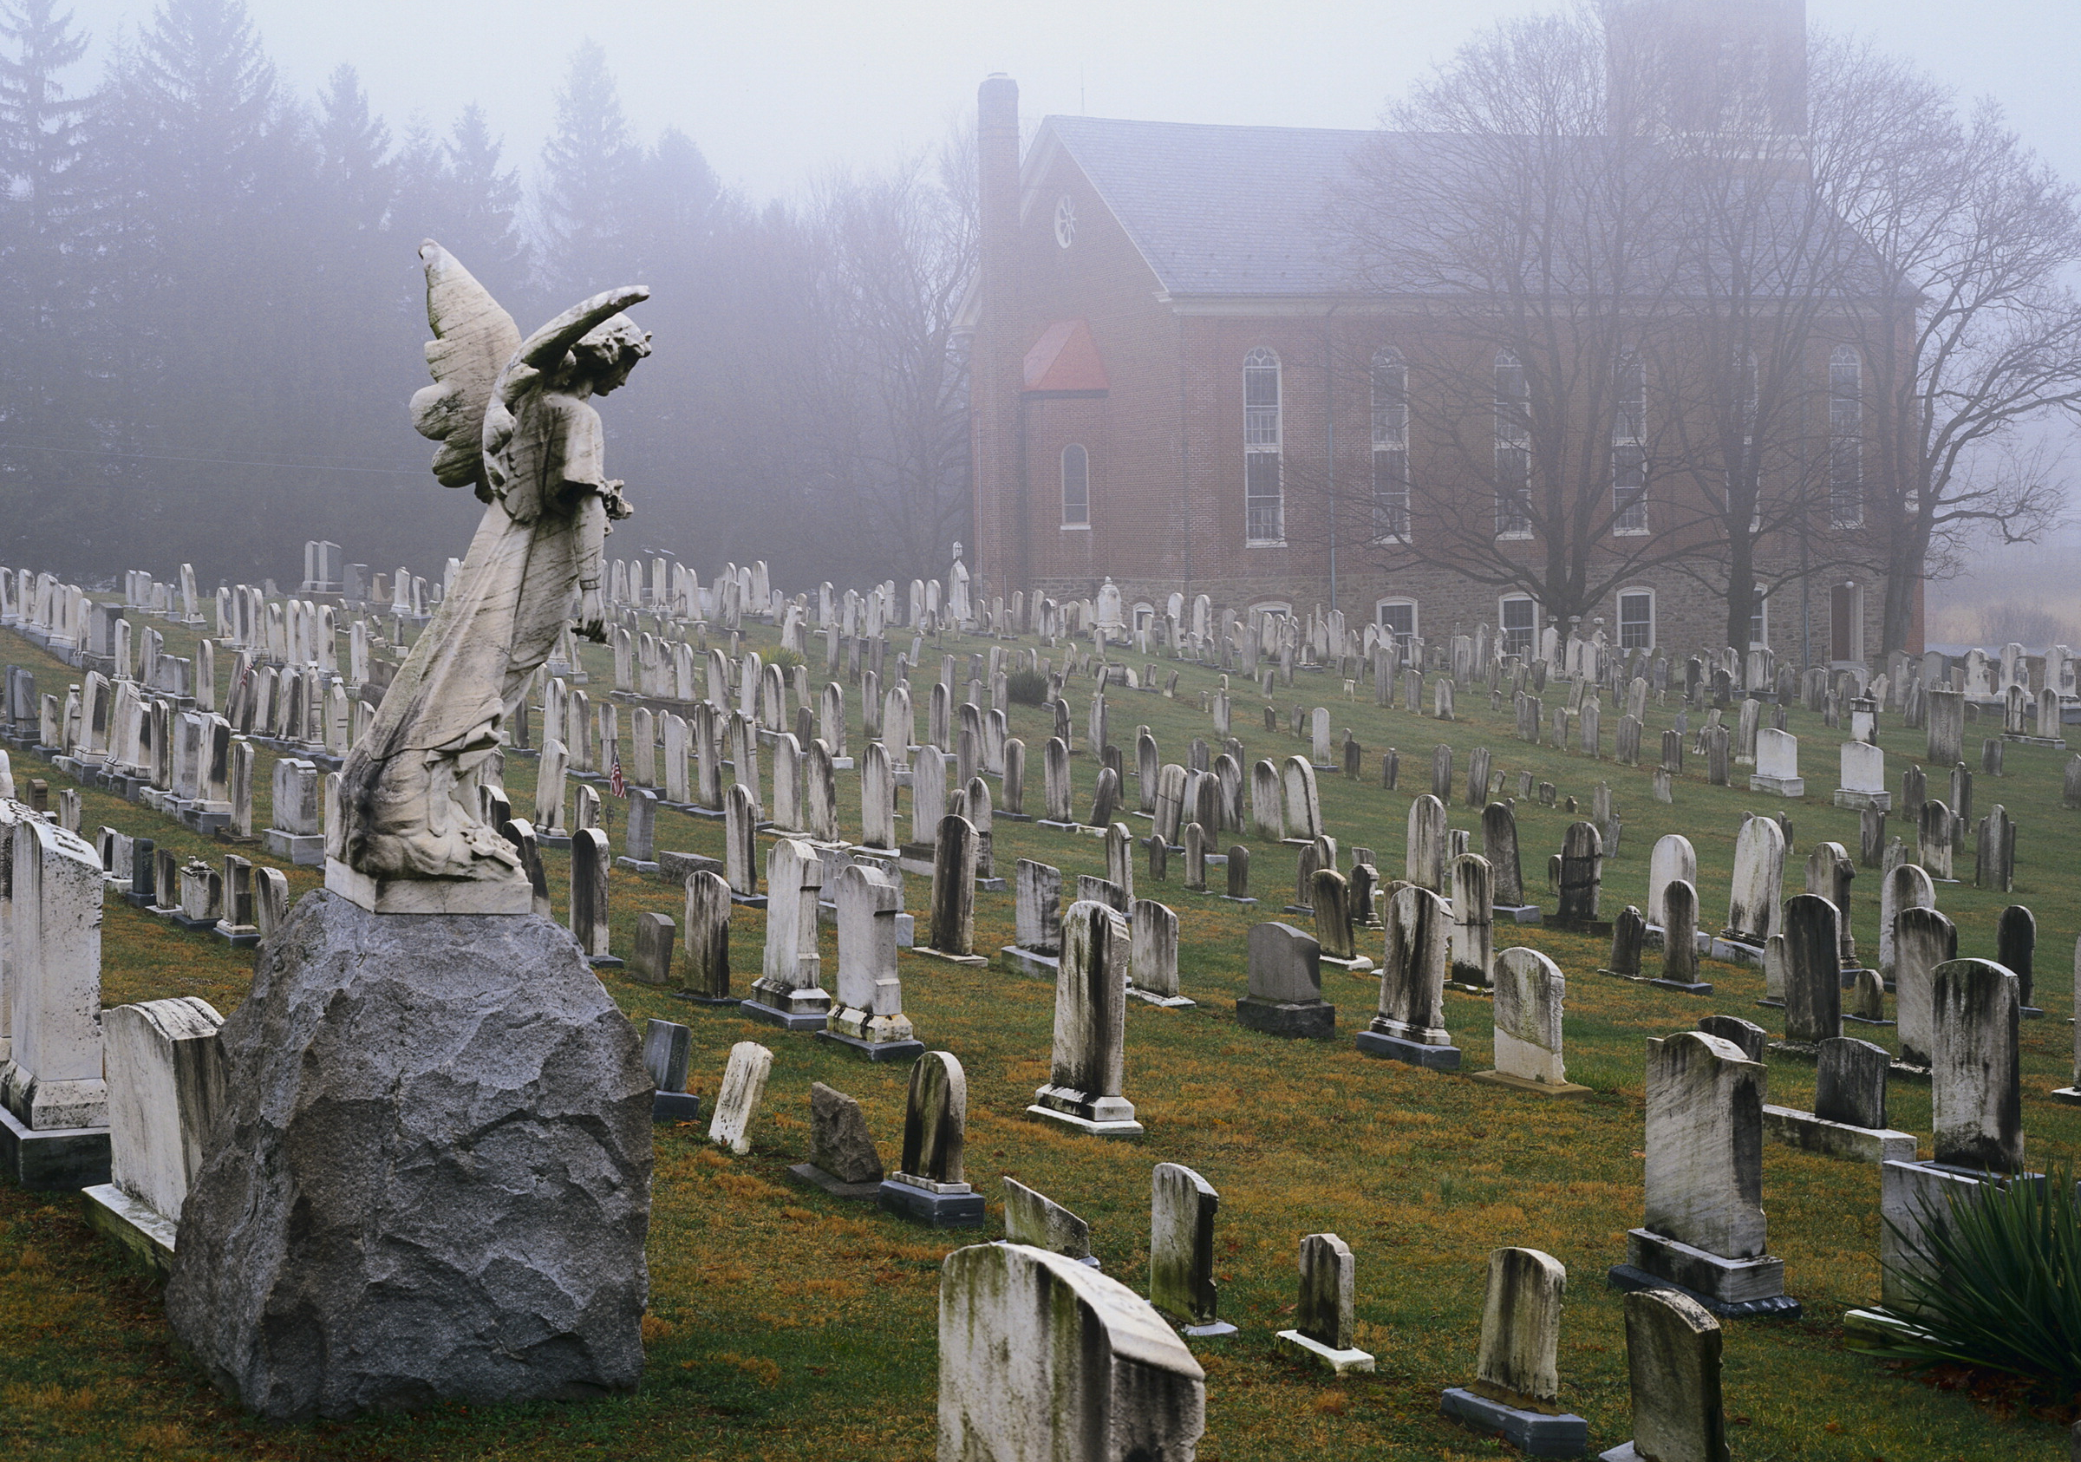
Key Facts
All events are told in the past from Jane’s point of view.
The setting is early 19th Century England.
Jane Eyre is classified as both a Gothic and a Romantic novel.

Slide 11
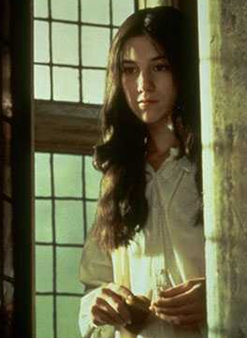
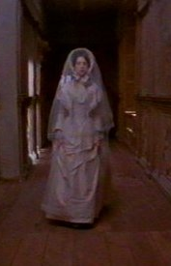
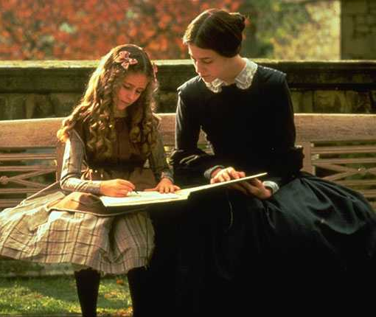
Jane Eyre
Our protagonist
Orphaned as a child
Becomes governess at Thornfield
A feisty young child, who grows into a strong woman.
Embodies the English working-class woman.
Will marry . . . . ?

Slide 12
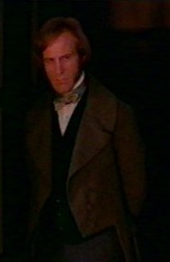
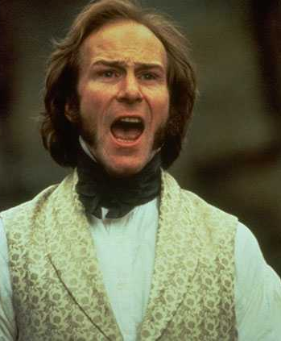
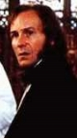
Edward Rochester
Jane’s boss at Thornfield
Gruff and rude
Made wealthy by family money
Benefactor to Adèle Varens
Very secretive and sometimes deceitful

Slide 13
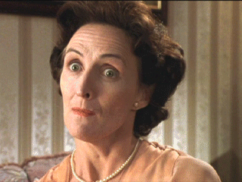
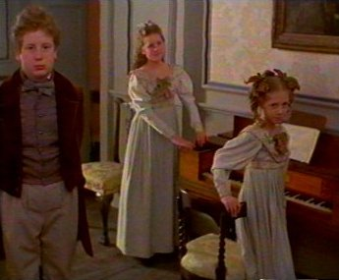
Reed Family
Jane’s family on her father’s side
Mrs. Reed is Jane’s cruel aunt who sends Jane to Lowood; she locks Jane in the “Red Room” for punishment
John, Eliza, and Georgiana are Jane’s spoiled cousins; they are rude and selfish; they either torment Jane or ignore her

Slide 14
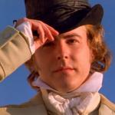
Rivers Family
Jane’s caretakers when she leaves Thornfield – are her cousins on her mother’s side.
St. John – Minister at Morton, tries to get Jane to be his missionary wife
Diana and Mary – kind and independent women, serve as role models for Jane (we only see one of the sisters [Mary] in the movie)
St. John Rivers

Slide 15
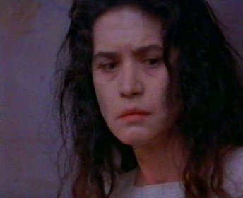
Bertha Mason
Bertha is locked in the attic at Thornfield
Starts the bedroom fire, and eventually burns the house down
Kills herself in the house fire
Exotic, sensual personification of the Orient
Why is she at Thornfield?

Slide 16
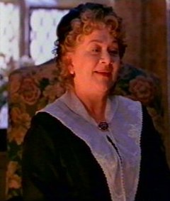
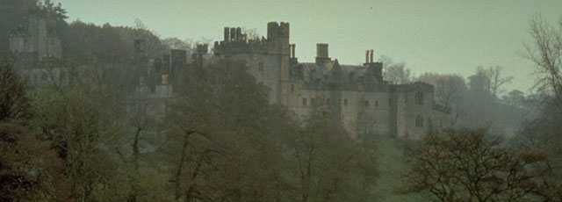
Mrs. Fairfax
Housekeeper at Thornfield
Serves as a mother figure/role model for Jane
Tells Jane about secrets of Thornfield and the Rochesters.
Thornfield Manor

Slide 17
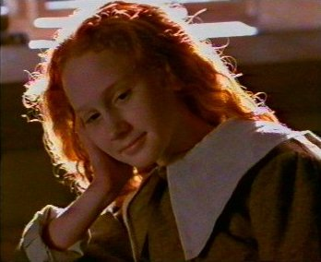
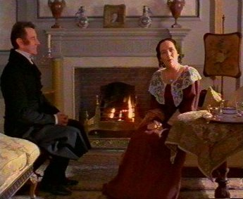
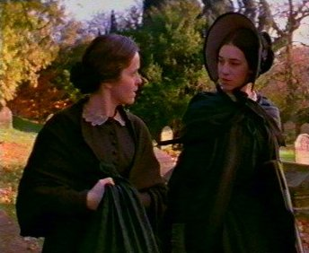
Other Characters
Helen Burns – Jane’s friend at Lowood, teaches her character, dies in Jane’s arms
Mr. Brocklehurst – cruel and dishonest master of Lowood School
Miss Temple – Jane’s favorite teacher, positive female role model/mother figure
Helen
Mr. Brocklehurst
Miss Temple

Slide 18
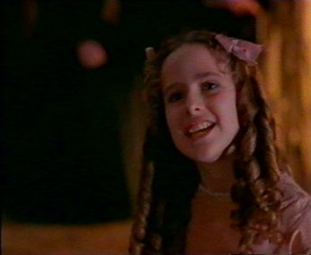
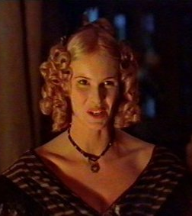
Other Characters (Cont.)
Grace Poole – Bertha’s mysterious keeper, serves as Bertha’s scapegoat
Adèle Varens – Jane’s pupil, daughter of Rochester’s old mistress, Celene
Richard Mason – Bertha’s brother, exposes the secret marriage
Blanche Ingram – socialite after Rochester’s money, opposite of Jane
Adèle
Blanche Ingram

Slide 19
Charlotte’s Gothic Influence
Jane Eyre displays some characteristics of the gothic novel:
  Imprisoned women
  A heroine who faces danger
  Supernatural interventions at crucial moments in the plot
  A romantic reconciliation

Slide 20

Jane Eyre’s Romantic Heritage
The Romantic Movement
  Came into play in at the end of the 18th Century.
  Championed for the rights of the individual over the demands of society.
  Believed that humans were inherently good
  Valued imagination over reason
  Inspired by nature

Slide 21
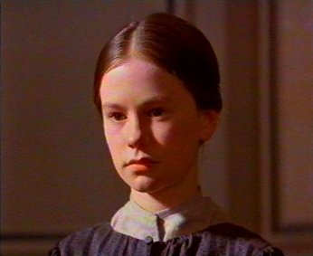
Introduction
Jane Eyre is an orphan in 1800s England.
  Jane’s parents died of typhus when she was a baby.
Mrs. Reed, her aunt, has agreed to raise her, but she and her three children treat Jane cruelly.
Yet, Mrs. Reed expects Jane to be thankful.

Slide 22
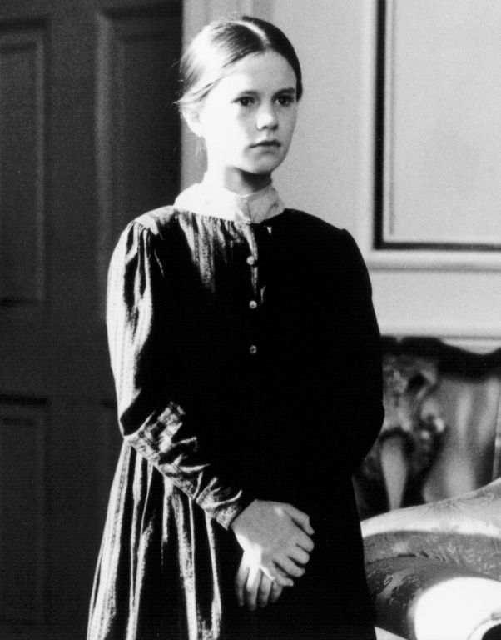
Jane Eyre: Introduction
When Jane tries to stand up for herself, her aunt is furious.
She calls Jane an ungrateful child and sends her away to a boarding school called Lowood.

Slide 23
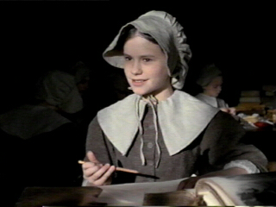
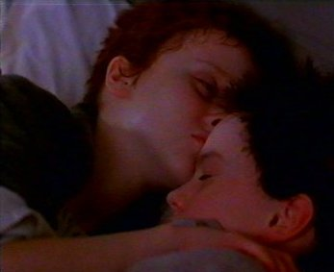
Jane Eyre: Introduction
At Lowood the girls . . .
sleep two to a bed,
get up before dawn,
bathe in ice-cold water,
get burnt porridge for breakfast,
and are taught to suffer in silence.

Slide 24
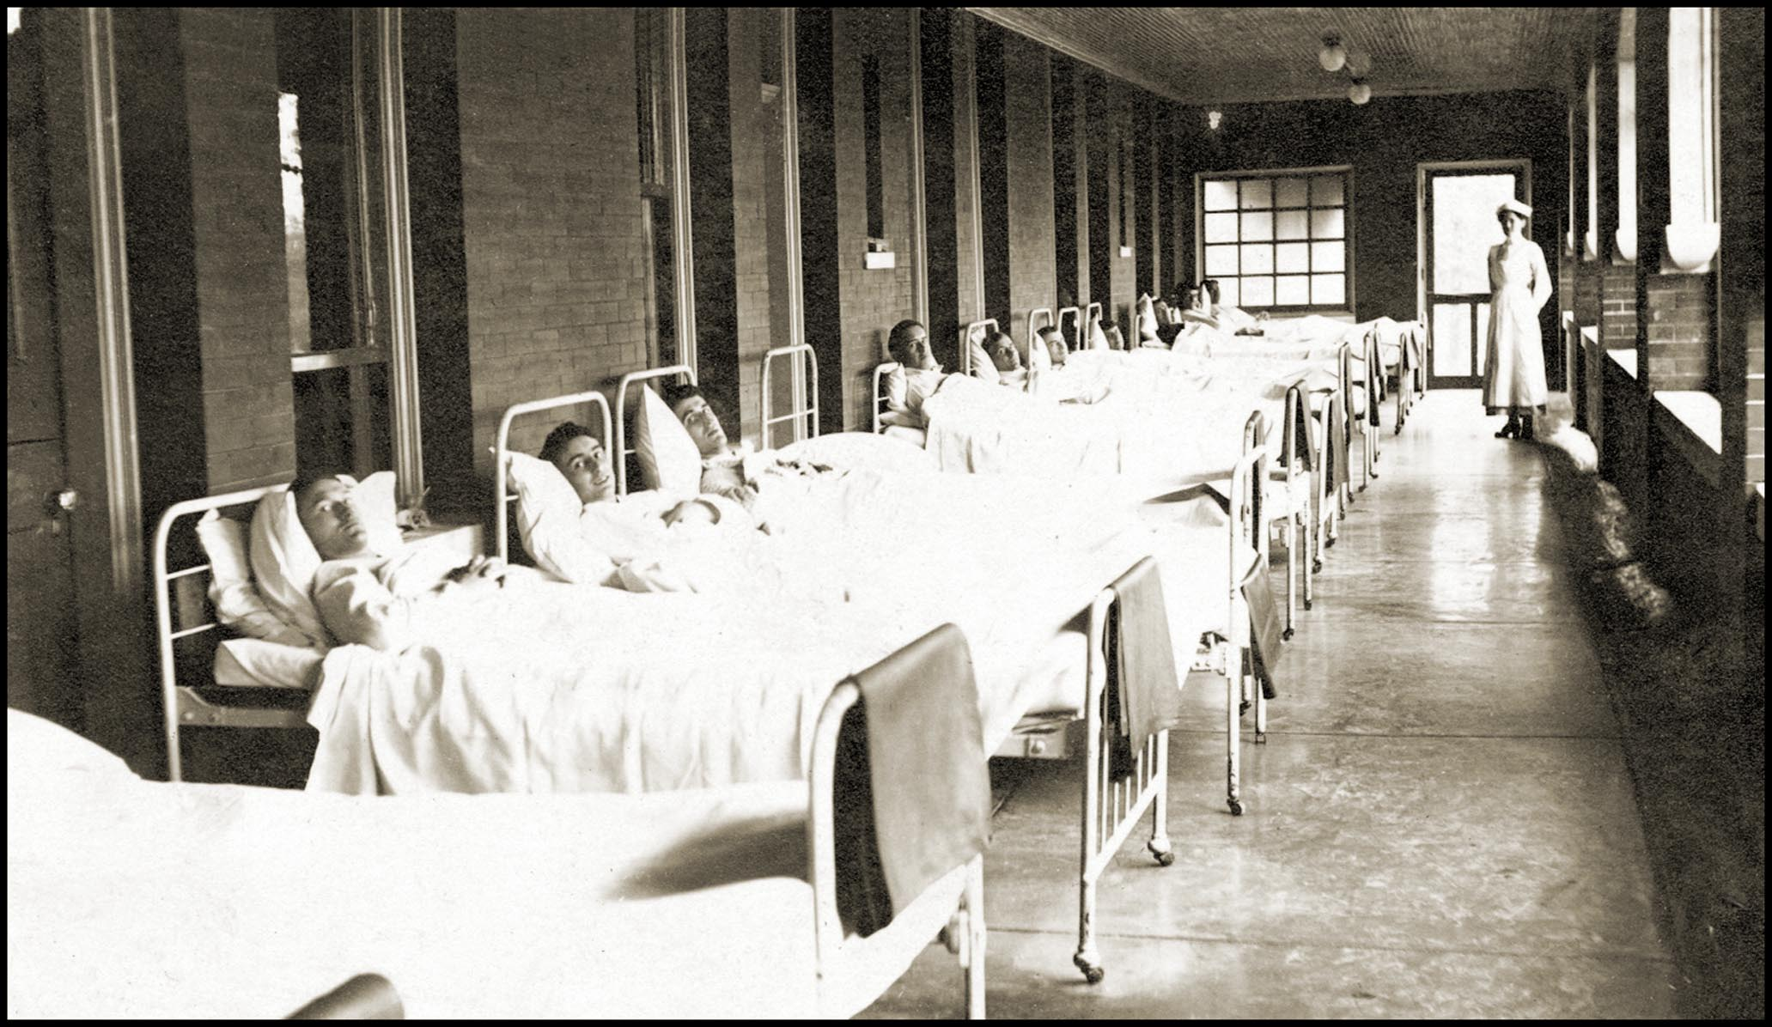
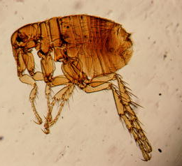
Typhus
Jane Eyre’s Lowood suffers an outbreak of typhus, a disease that
  is spread by fleas, ticks, and lice
  causes headaches, chills, rashes, and fevers that last up to three weeks
Both tuberculosis and typhus are diseases associated with crowded, unsanitary conditions.
The threat of catching one of these diseases is a major concern for the characters in Jane Eyre.

Slide 25
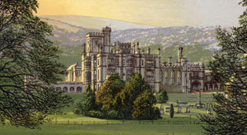
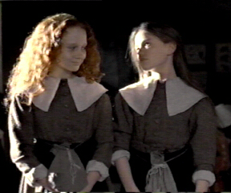
Life at Lowood
The superintendent of
Lowood School is Mr. Brocklehurst.
Jane immediately makes friend with a girl called Helen Burns.
She also admires her head teacher Miss. Temple.
As a consequence of bad conditions, typhus breaks out. Many girls die, including Helen, Jane’s best friend
Jane stays at Lowood eight years as a pupil and then two years as a teacher.

Slide 26
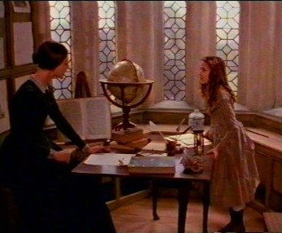
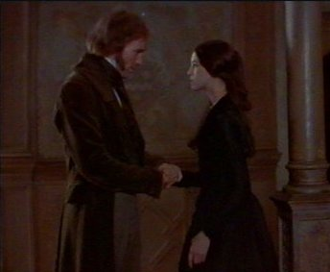
Thornfield Hall
After posting an advertisement in a local paper, Jane becomes the private governess at Thornfield Hall.
Her pupil is a young French girl named Adele.
Thornfield Hall belongs to a Mr. Rochester
  Jane does not meet him for months.
  Finally, Mr. Rochester returns home and stays longer than usual at Thornfield Hall

Slide 27
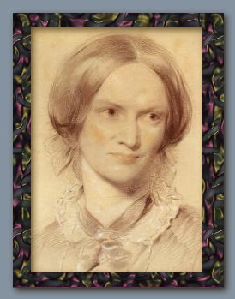
Role of the Governess
With the new stress on female education, governesses were in demand.
Pay was poor, but it was one of the only jobs available to educated, yet impoverished young women.
Employers & other servants often shunned the governess because they felt they were “putting on airs.”
Their employers would often ignore them, too, because they had a superior education, which intimidated many people – especially men.

Slide 28
Mysteries . . .
One night at Thornfield, Jane wakes up and hears evil laughter...
  Who could this be?
  What is going on in Mr. Rochester’s bedroom?
One day Mr. Rochester gives a party for some fine guests. In attendance is a Miss. Ingram, a beautiful woman, who adores Mr. Rochester. During the party a Mr. Mason arrives.
  Who is this mysterious man?
  What is he doing at Thornfield?
  What will happen to him?
One day Jane receives a letter regarding Mrs. Reed, her wicked aunt. Mrs. Reed is dying and wants to see Jane again.
  Why would she want to see Jane again?
  What secret does she possess?
When Jane comes back to Thornfield Hall, Mr. Rochester is very happy to see her again. He gives Jane the news that he has decided to marry.
  Who will he marry?
  Will the wedding actually take place?

Slide 29
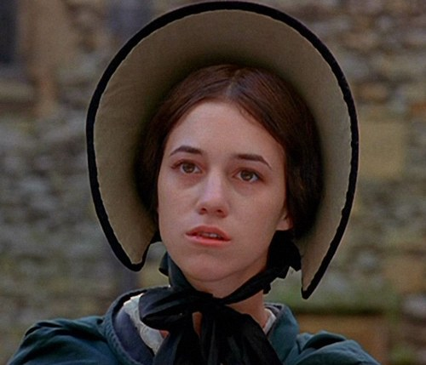
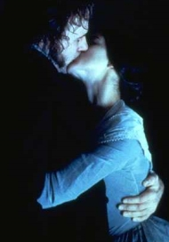

Jane Eyre:
A Ground Breaking Novel
  The heroine is small, plain, & poor
  The heroine is the first female character to claim the right to feel strongly about her emotions and act on her convictions
  This romantic ground had previously been reserved for males
  Such a psychologically complex heroine had never been created before

Slide 30
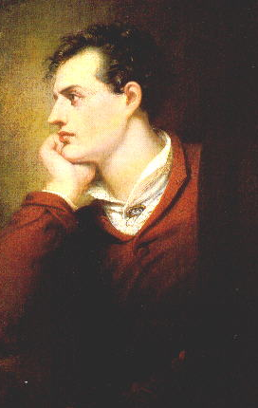
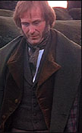
Byronic Hero
This term is created by the famous poet George Gordon, Lord Byron.
Characteristics are…
  Proud
  Gloomy
  Mysterious
  Passionate
  *Mr. Rochester is an example of this type

Slide 31

Love
Jane is constantly in a search for love.
She is searches for romantic love in Rochester, motherly love through Miss Temple and Mrs. Fairfax, and friendship through the Rivers siblings, Helen Burns, and Rochester.
Jane’s search for love might stem from the scorn she felt as a child

Slide 32
Social Class
Jane often feels inadequate compared to many of the other main characters in the novel.
Jane feels that her love for Rochester is wrong because she isn’t from the same class.
Class segregates Jane from her cousins on both sides, although it is more obvious on the Reed side.
Blanche Ingram is the class opposite of Jane.

Slide 33
Religion
Religion plays a huge role in this novel.
Helen Burns taught Jane a view of faith and God that she could understand.
Mr. Brocklehurst’s Evangelical view had negative effects on Jane, as did St. John River’s Empirical view.
Even the once cruel Eliza Reed joins a French convent.

Slide 34

Mother Figures
In her search for love, Jane also looks for the mother figure that she missed as a child.
Jane finds the characteristics she is looking for in:
  Miss Temple
  Mrs. Fairfax
  Rivers sisters

Slide 35
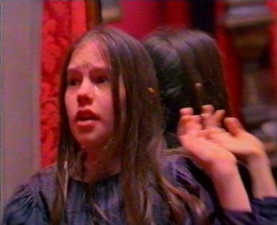
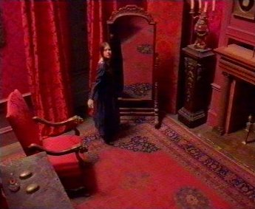
Red Room
The room at Gateshead where Uncle Reed died, and where Jane was locked up to be punished.
This punishment haunted Jane for the rest of her life.
Memories of the night in the Red Room occur when Jane is at a crossroads in her life.

Slide 36
This powerpoint was kindly donated to www.worldofteaching.com
http://www.worldofteaching.com is home to over a thousand powerpoints submitted by teachers. This is a completely free site and requires no registration. Please visit and I hope it will help in your teaching.

